Slide 1

Final Milestone Presentation:
Archway
CSI 43C9
Pariveda 3, Section 2 Group 3

Slide 2
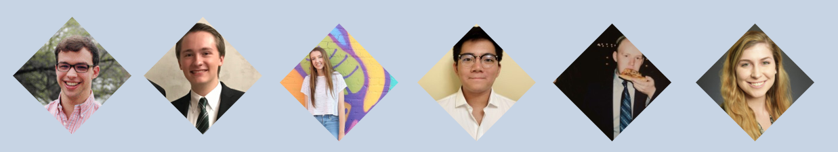
Meet the Team
LIAISON
DEPUTY

Slide 3
PRESENTATION OVERVIEW
Business Problem
Our Solution
Demo
What’s Next?
Why Archway?

Slide 4

1
BUSINESS PROBLEM

Slide 5
BUSINESS PROBLEM
Capstone projects are largely buried in department pages
No centralized and controlled solution to showcasing capstones
No easy way for sponsors to get involved in the capstone process
Must go through IT webmasters just to get a capstone updated or published
Difficult to organize interdisciplinary projects
There is no easy way to showcase and manage capstones.
Notes:
David sait to make it a “story,” so give the problem context

Slide 6
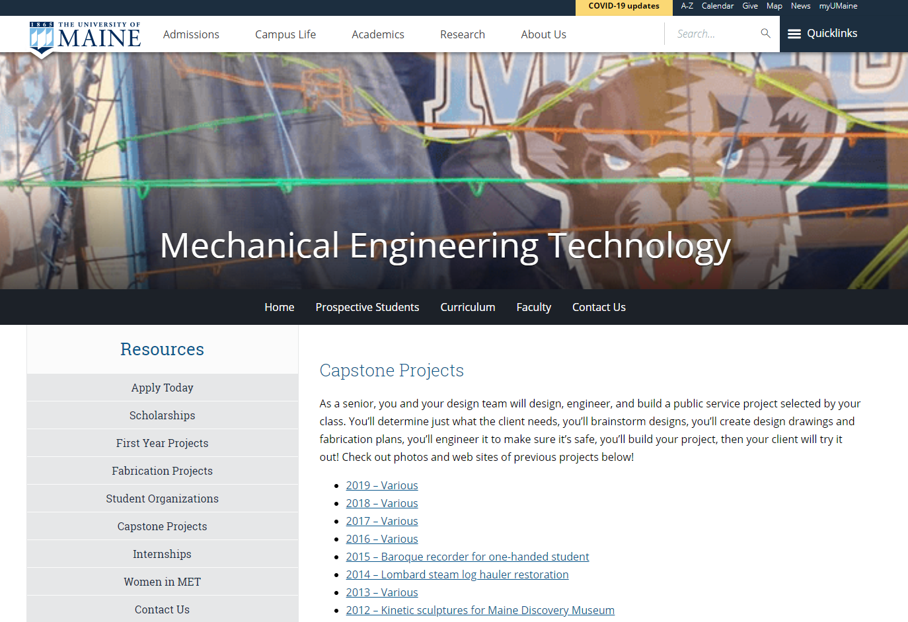
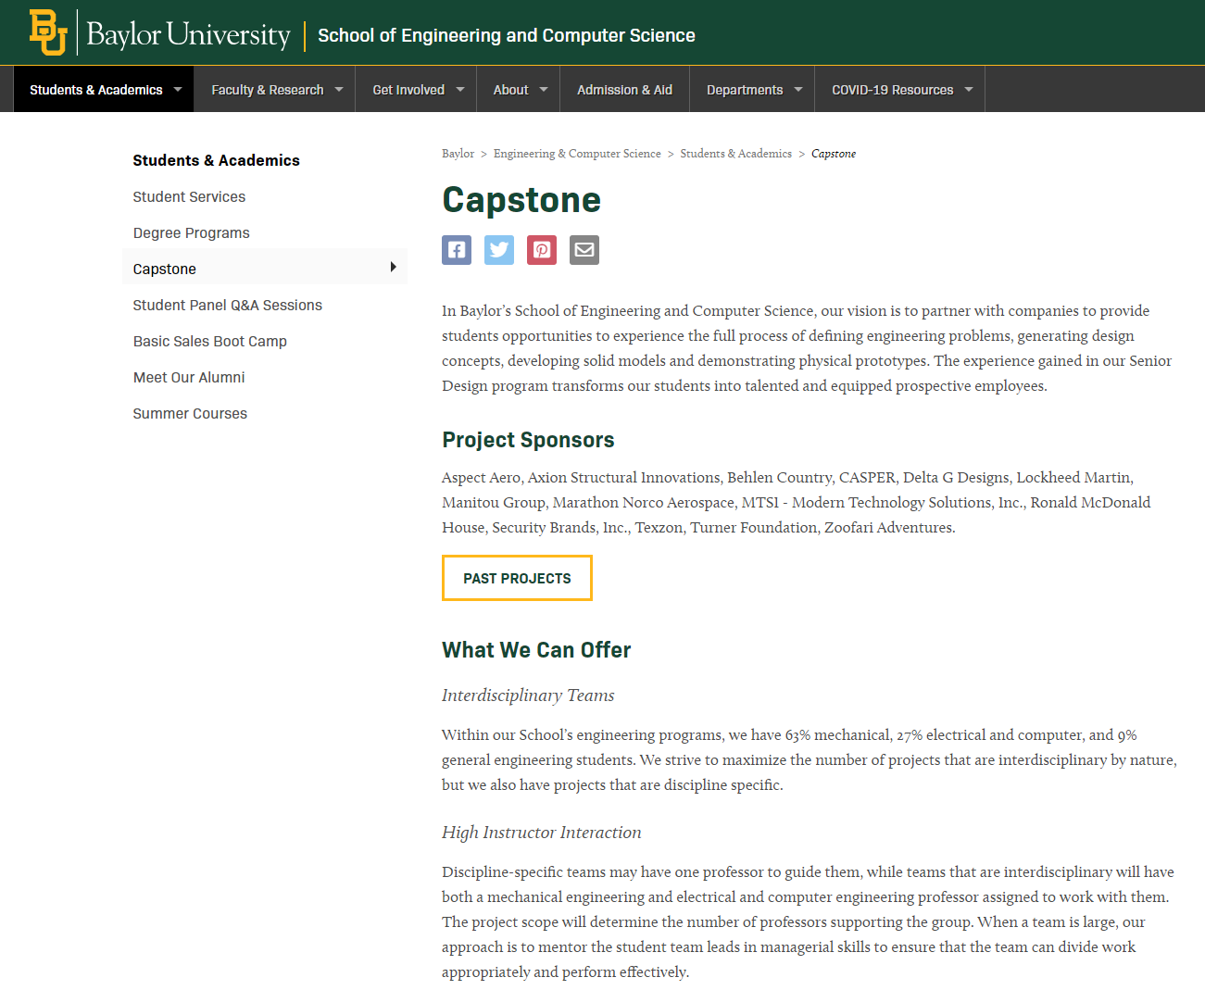
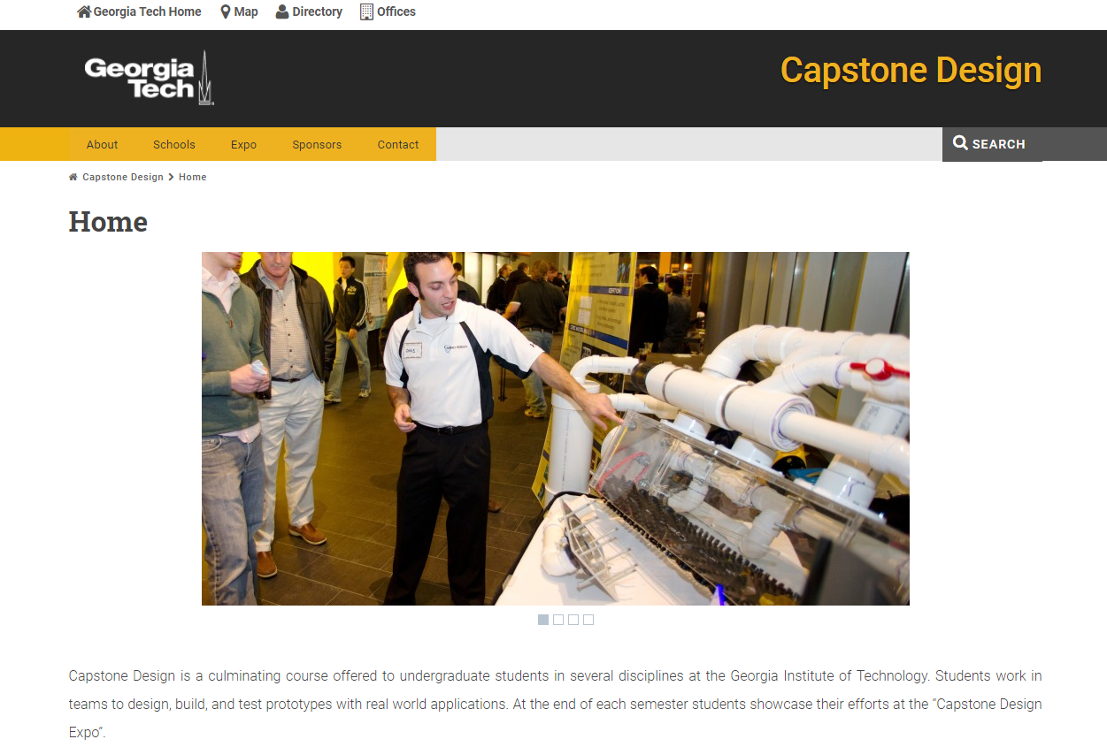
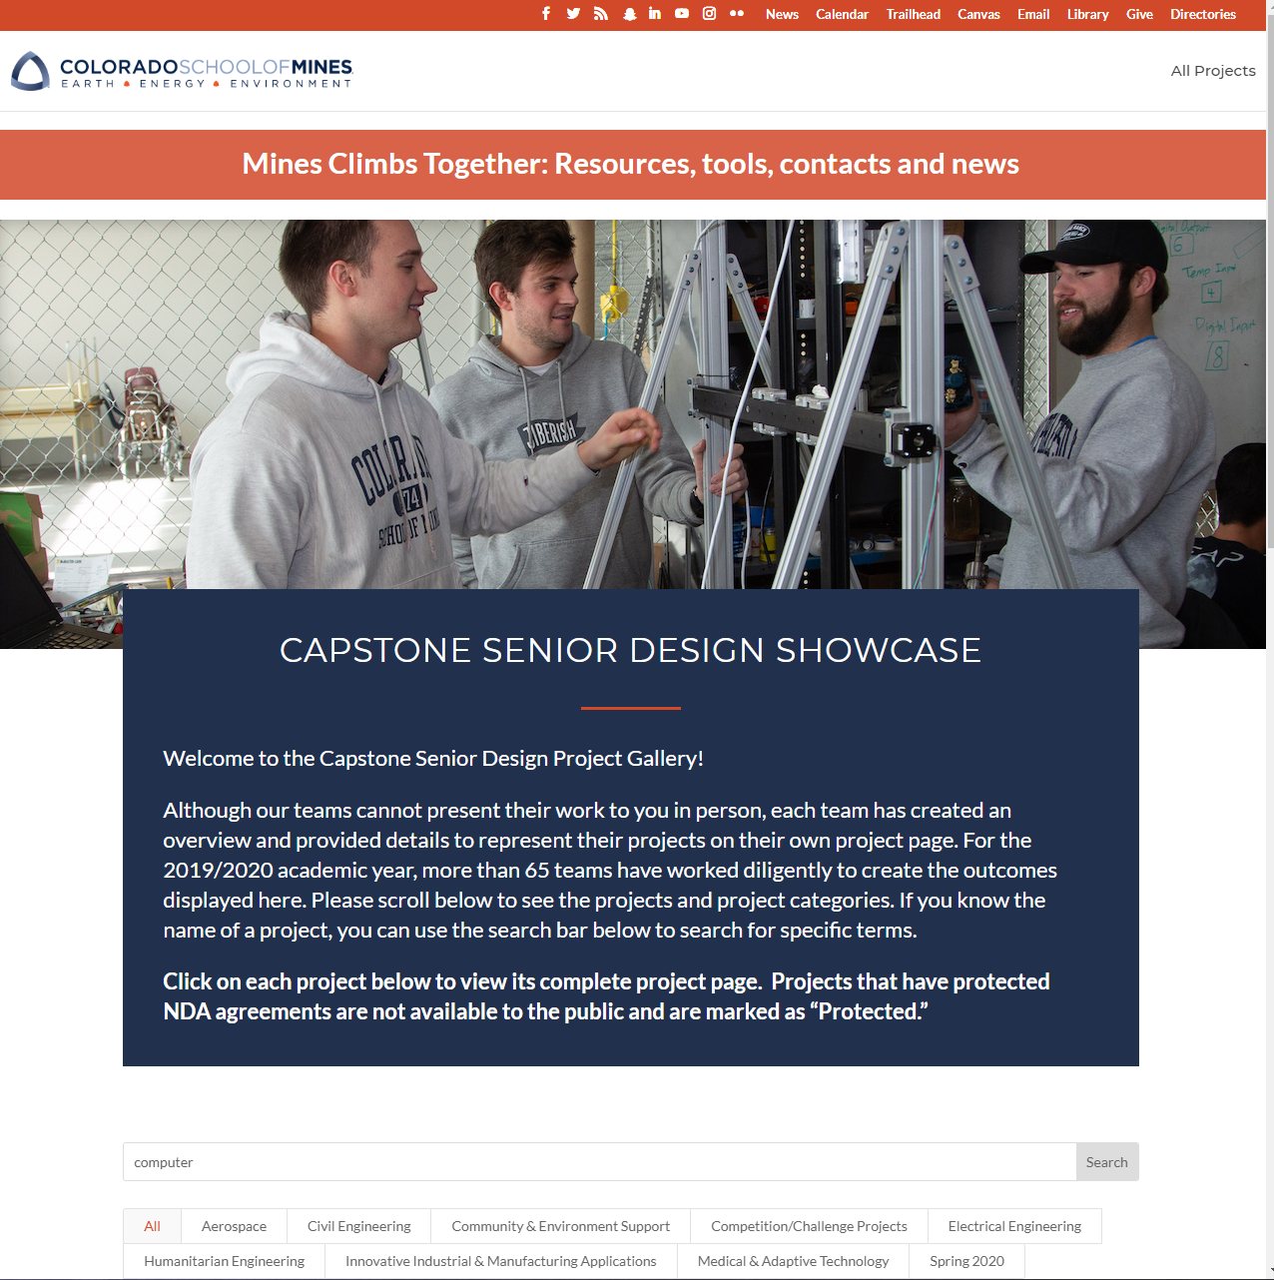
PAST SOLUTIONS

Slide 7
2
OUR SOLUTION

Slide 8

OUR SOLUTION
Archway is a Capstone Management System (CMS) that provides universities with a centralized and configurable software solution to manage and showcase capstones.
Notes:
Jack
Here you can see our mission statement, and I wanted to point out the two key components that will be demonstrated throughout the presentation. That is, that Archway is both centralized and configurable.

Slide 9
HOW DOES ARCHWAY COMPARE
Requirement | Typical Static Capstone Showcases | Archway CMS
Showcases capstones | ✔️ | ✔️
Centralized solution for browsing all university capstones | ❌ | ✔️
Caters towards key stakeholders such as sponsors, professors, and university marketing | ❌ | ✔️
Facilitates interdisciplinary, cross-department projects | ❌ | ✔️
Built for dynamic configuration | ❌ | ✔️
Modern UI/UX solution that can be extended and maintained | ❌ | ✔️
Notes:
Jack
Like Sean pointed out, Baylor’s current solution to capstone showcases includes having different departments have their own capstone webpages, some of which are more fleshed out than others. With Archway, universities can display all of their capstones in one place. This centralized solution caters towards key stakeholders such as sponsors who are looking to contribute to a project or perhaps even propose a new project of their own. Archway also supports interdisciplinary capstone projects. For example, some gaming projects here at Baylor have partnered with the art department to design concept art for their games, and Archway highlights this in a way that most other capstone showcases do not. Furthermore, we know that when it comes to your brand, image is everything. That’s why we created Archway to be highly configurable with a modern look and feel.

Slide 10

KEY FEATURES
Functional
Configurable theming
Dynamic navbar and footer
In-app markdown editor support (with embedded images and HTML support)
Features catered towards user-personas
Email confirmation authentication system
Admin panel UI
Role Based Access Control (RBAC)
Notes:
Jack
Some of these configuration options include configurable theming allowing you to change the color scheme of the entire application, a dynamic navbar and footer, and a markdown editor that allows you to easily create professional looking formatted text and HTML components within the app. Some other key features include our new authentication system complete with email confirmation, and our role based access control policy that limits what different users can do based on their permissions, all of which is configurable from our admin panel. That means that as an admin, you can create new user roles, change their permissions, and start using them in the app. So now that you know more about our solution to the business problem, Katy is going to talk a little more about our technical solution.

Slide 11
TECHNICAL SOLUTION

Slide 12
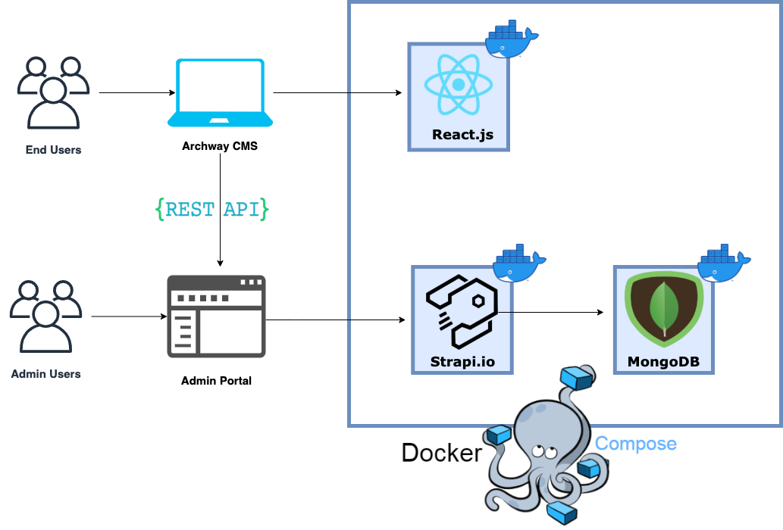
Technical
Architecture

Slide 13
3
DEMO

Slide 15
4
WHAT’S NEXT?

Slide 16






Looking Back
Rebrand
Rework home page, sponsor page, footer
Wireframe other pages
Search page
University Marketing
User Dashboards
RBAC Permissions
Evaluate Business Problem
Develop Initial Solutions
Research Technologies
We are here!
Sprint 0
✔️
Sprint 1
✔️
Sprint 2
✔️
Sprint 3
✔️
Sprint 4
✔️
Sprint 5
✔️
Sprint 6
Define user stories
Setup environments
Update tech, packages
Export/Import scripts
Create all major form pages
Rework existing pages into updated look
Redesign backend schema
Email notifications
Better TA/Prof management
In depth documentation
Dynamic header/footer

Slide 17
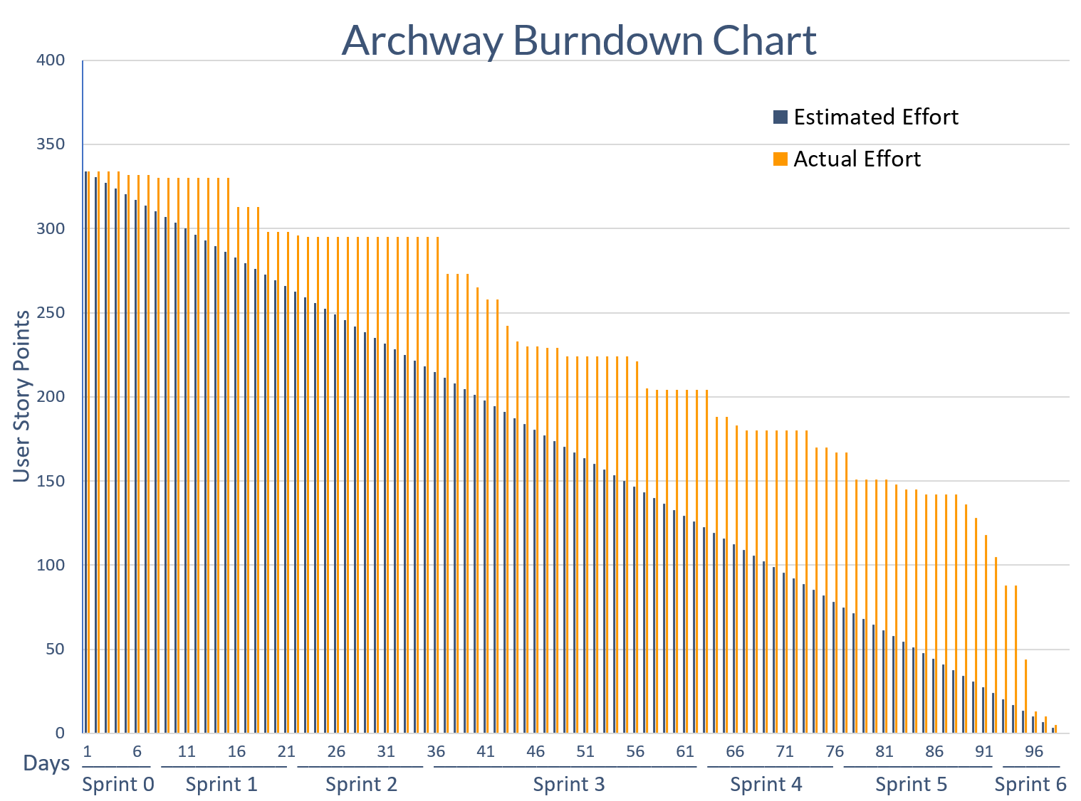
Musts and Shoulds
HELLO!
I AM DAVID PORTER

Slide 18
Features for Future Development
CI/CD
3rd party authentication providers
Sitemap for SEO
Kubernetes scaling
Admin panel outside of Strapi for configuration
Improved searching (tags)
Customizable layouts in-app
Better social media integration
Improved searching (tags)
‘Showcase Day’ system and awards
Interaction with public through blog/news
Notes:
As Sean said, we finished what we set out to do and we are proud of what we accomplished. With more time, of course there are plenty of features that we would consider developing. Given our limited physical access to the server and time constraints, we were unable to fully configure the server and set up CI/CD, but we recognize the importance if it. We would also include additional security and optimization in the forms of 3rd party authentication, sitemap, and Kubernetes. Additional configurability within the app in the form of an admin panel and customizable forms and layouts would eliminate the limitation of having to access Strapi admin directly. And we would increase ways to interact with the app through social media, tag based search, showcases, awards and adding blog or news functionality. While we have identified what we would do with more time, we are confident in our application and Caleb and Yunzhe will highlight why Archway is the solution.

Slide 19
5
WHY ARCHWAY
Notes:
Caleb
After looking back at what we’ve done and what we would do with more time, let’s recap what makes Archway currently better than the rest.

Slide 20

Configurability
Header/navbar
Footer
Home/About/FAQ pages
Theming
RBAC
Markdown/HTML support
No external Auth0 dependency
Notes:
Caleb
One of the largest selling points of our application is its configurability. Everything ranging from the theme to the footer is configurable, making it very easily transferred to a new university or college. We utilize markdown to allow for individual page customization, as well as a dashboard within Strapi to manage the themes easily. This all comes together to make a very malleable, configurable application.

Slide 21

Maintainable Codebase
Rewrote app with improved coding practices
Peer code reviews and merge requests
Automated linting and consistent code quality
Componentization and configurability
Notes:
Caleb
There is more to Archway than its configurability, however. The code that makes up Archway is maintainable and efficient. We chose to rewrite the application while keeping as many components as possible from the previous capstone team. We did this with the goal in mind of any future teams NOT needing to do that. What that means is that we followed standard industry procedure, such as peer code reviews and merge requests, as well as consistent code quality through automated linting. In addition to that, everything is split up into components, which allows for configurability on the backend as well. This maintainable codebase, while not being seen by the end user, will make further maintaining and developing on Archway much easier and less stressful.

Slide 22

Documentation
Improved
Detailed programmer guide
In-depth installation guide
Wireframes and design documents
Admin and end-user guide

Slide 23
Questions?

